Slide 1
INTERNET SAFETY
FOR THE „POWER SICILY” LANGUAGE PREPARATION

Slide 2
INTERNET SAFETY – DEFINITION AND SYNONYMS
Internet safety or online safety or cyber safety or e-safety
is the act of maximizing a user's awareness of personal safety and security risks to private information and property associated with using the internet, and the self-protection from computer crime.

Slide 3
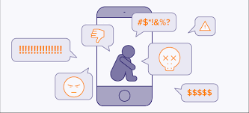
RISKS – nearly 50% children and teenagers have experienced cyber-harassment.
Even though the Internet can be a wonderful tool for children and teenagers (they can use it to do research for schoolwork, communicate with teachers and other children), online access also comes with risks, such as inappropriate content, cyberbullying and online predators.

Slide 4
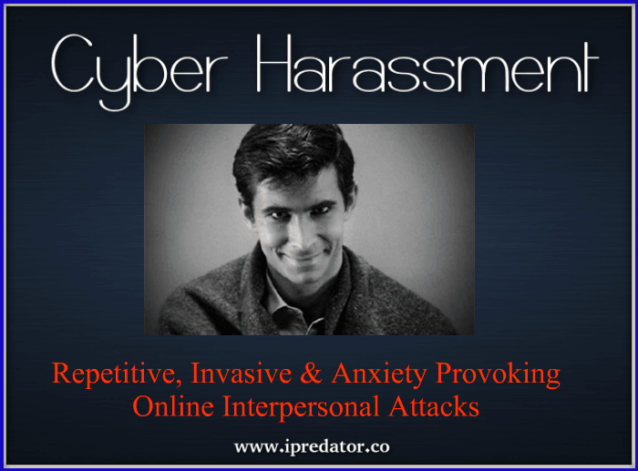
RISKS – nearly 50% children and teenagers have experienced cyber-harassment.
They say they have:
been contacted online by someone they didn't know in a way that made them feel scared or uncomfortable
received online advertising that was inappropriate for their age
lied about their age to get access to websites

Slide 5
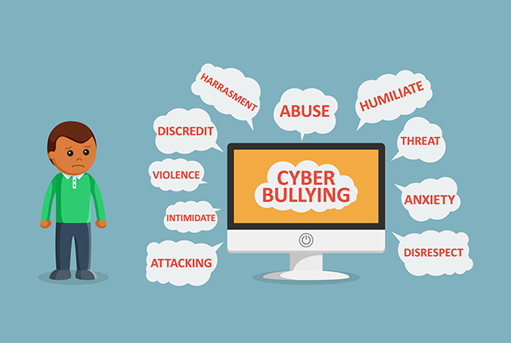
What Is Cyberbullying?
Cyberbullying is when someone uses technology to harass, threaten, embarrass, or target another person. It happens on devices like smartphones, computers, tablets, and gaming systems. Cyberbullying hurts people, and in some cases is against the law.
Sometimes cyberbullying can be easy to spot — for example, if your child shows you a text, comment, or post that is harsh, mean, or cruel. Other acts are less obvious, like posting someone's personal information, or using photos or videos that hurt or embarrass another person. Someone might make a fake account or screen name to harass and bully, so you don't know who the bully is.

Slide 6
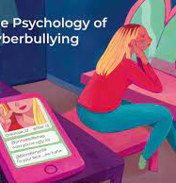
What Are the Effects of Cyberbullying?
Young people have almost constant access to their devices, so cyberbullying is hard to escape. Children and teenagers can feel like they never get a break and feel the effects very strongly.
Cyberbullying that is severe, long-lasting, or happens a lot can cause anxiety, depression, and other stress-related disorders in victims and bullies. In rare cases, some kids have attempted or died from suicide.
Cyberbullies also can be suspended or expelled from school or kicked off of sports teams. Depending on the severity of the cyberbullying, they also might be in legal trouble.

Slide 7
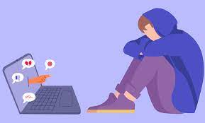
What Are the Signs of Cyberbullying?
Many kids and teens who are cyberbullied don't want to tell a teacher, parent, or trusted adults, often because they feel ashamed or fear that their devices will be taken away at home.

Slide 8
What Are the Signs of Cyberbullying?
Signs of cyberbullying vary, but may include:
being emotionally upset during or after using the Internet or the phone
being very secretive or protective of one's digital life
spending more time than usual in their room
withdrawal from or lack of interest in family members, friends, and activities
avoiding school or group gatherings
slipping grades and "acting out" in anger at home
changes in mood, behavior, sleep, or appetite
suddenly wanting to stop using the computer or device
being nervous or jumpy when getting a message, text, or email
avoiding discussions about computer or phone activities

Slide 9
HOW TO STAY SAFE
Internet Safety Laws
Online Protection Tools (allows access control to adult material and help protect children from Internet predators. Many Internet service providers (ISPs) provide parent-control options. Software that helps block access to sites and restricts personal information from being sent online can also be obtained. Other programs can monitor and track online activity).
Getting Involved in Choldren’s Online Activities – parental role

Slide 10
Teaching Young People to Be Smart About Social Media
Most teenagers use some form of social media and have a profile on a social networking site. Many visit these sites every day.
There are plenty of good things about social media — but also many risks and things youngsters should avoid. They don't always make good choices when they post something to a site, and this can lead to problems.
So it's important to use social media wisely.

Slide 11
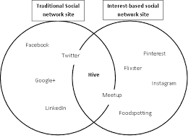
What's Good About Social Media
Social media can help young people:
stay connected with friends and family
volunteer or get involved with a campaign, nonprofit, or charity
enhance their creativity by sharing ideas, music, and art
meet and interact with others who share similar interests
communicate with educators and fellow students

Slide 12
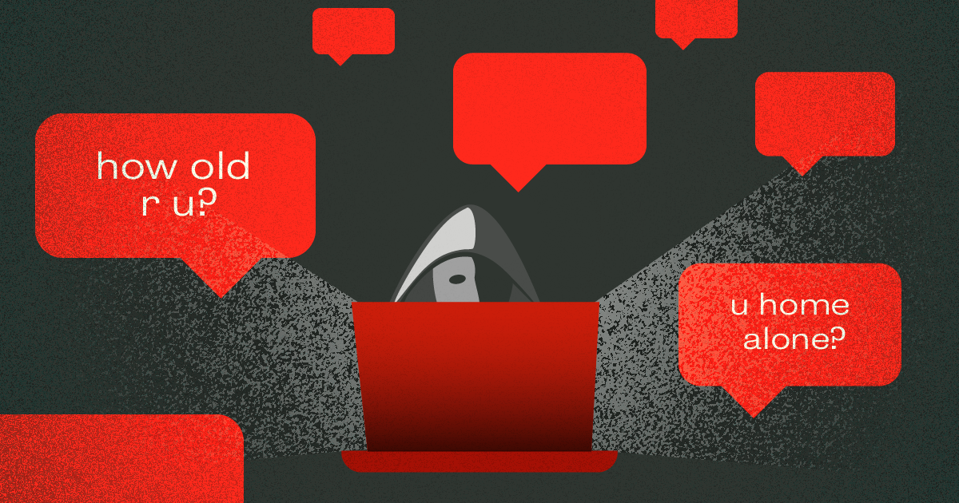
What's Bad About Social Media
Most teenagers:
post photos of themselves online or use their real names on their profiles
reveal their birthdates and interests
post their school name and the town where they live
This can make them easy targets for online predators and others who might mean them harm.

Slide 13
Concerns and Consequences
Besides problems like cyberbullying and online predators, teenagers also can face the possibility of a physical encounter with the wrong person. Many newer apps automatically reveal the poster's location when they're used. This can tell anyone exactly where to find the person using the app.

Slide 14
Concerns and Consequences
And photos, videos, and comments made online usually can't be taken back once they're posted. Even when a teen thinks something has been deleted, it can be impossible to completely erase it from the Internet.

Slide 15
Concerns and Consequences
Posting an inappropriate photo can damage a reputation and cause problems years later — such as when a potential employer or college admissions officer does a background check. And sending a mean-spirited text, even as a joke, can be very hurtful to someone else and even taken as a threat.

Slide 16
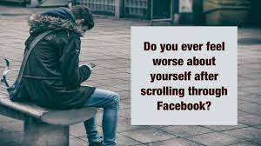
Concerns and Consequences
Spending too much time on social media can be a downer too. Seeing how many "friends" others have and the pictures of them having fun can make young people feel bad about themselves or like they don't measure up to their peers.

Slide 17
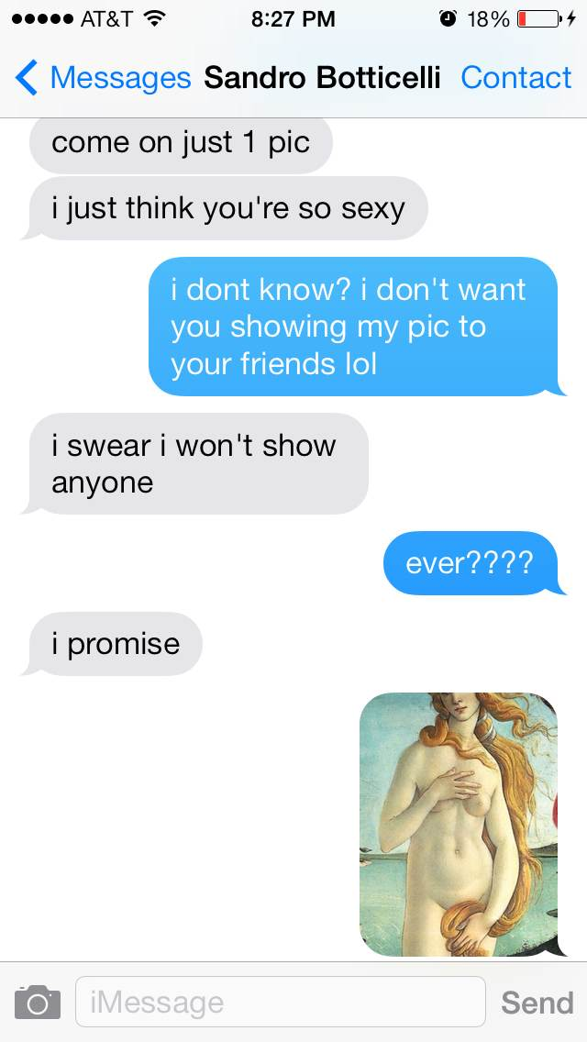
What Is Sexting?
Sexting (or "sex texting") is sending or getting sexually explicit or suggestive images, messages, or video on a smartphone or through the Internet.
Sexting includes sending:
nude or nearly nude photos or selfies
videos that show nudity, sex acts, or simulated sex
text messages that propose sex or refer to sex act

Slide 18
Phishing
It is a type of scam where the scammers disguise as a trustworthy source in attempt to obtain private information such as passwords, and credit card information, etc. through the internet. These fake websites are often designed to look identical to their legitimate counterparts to avoid suspicion from the user.

Slide 19
Malware
Particularly spyware, is malicious software disguised as software designed to collect and transmit private information, such as password, without the user's consent or knowledge. They are often distributed through e-mail, software and files from unofficial locations. Malware is one of the most prevalent security concerns as often it is impossible to determine whether a file is infected, despite the source of the file.

